Slide 1


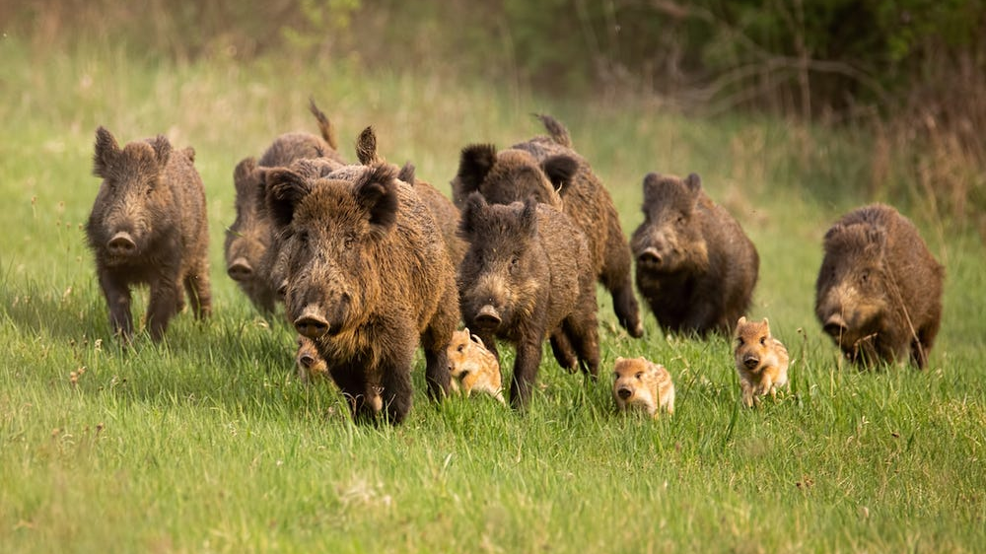
Game tracker
18-week, asp.net mvc core web application for mssa
Josh Applegarth

Slide 2
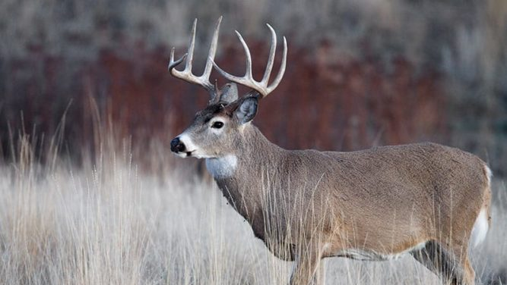
Agenda
Overview
Demo
Improvements
Technology Used

Slide 3
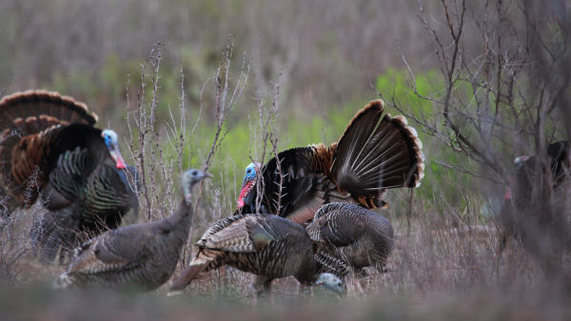
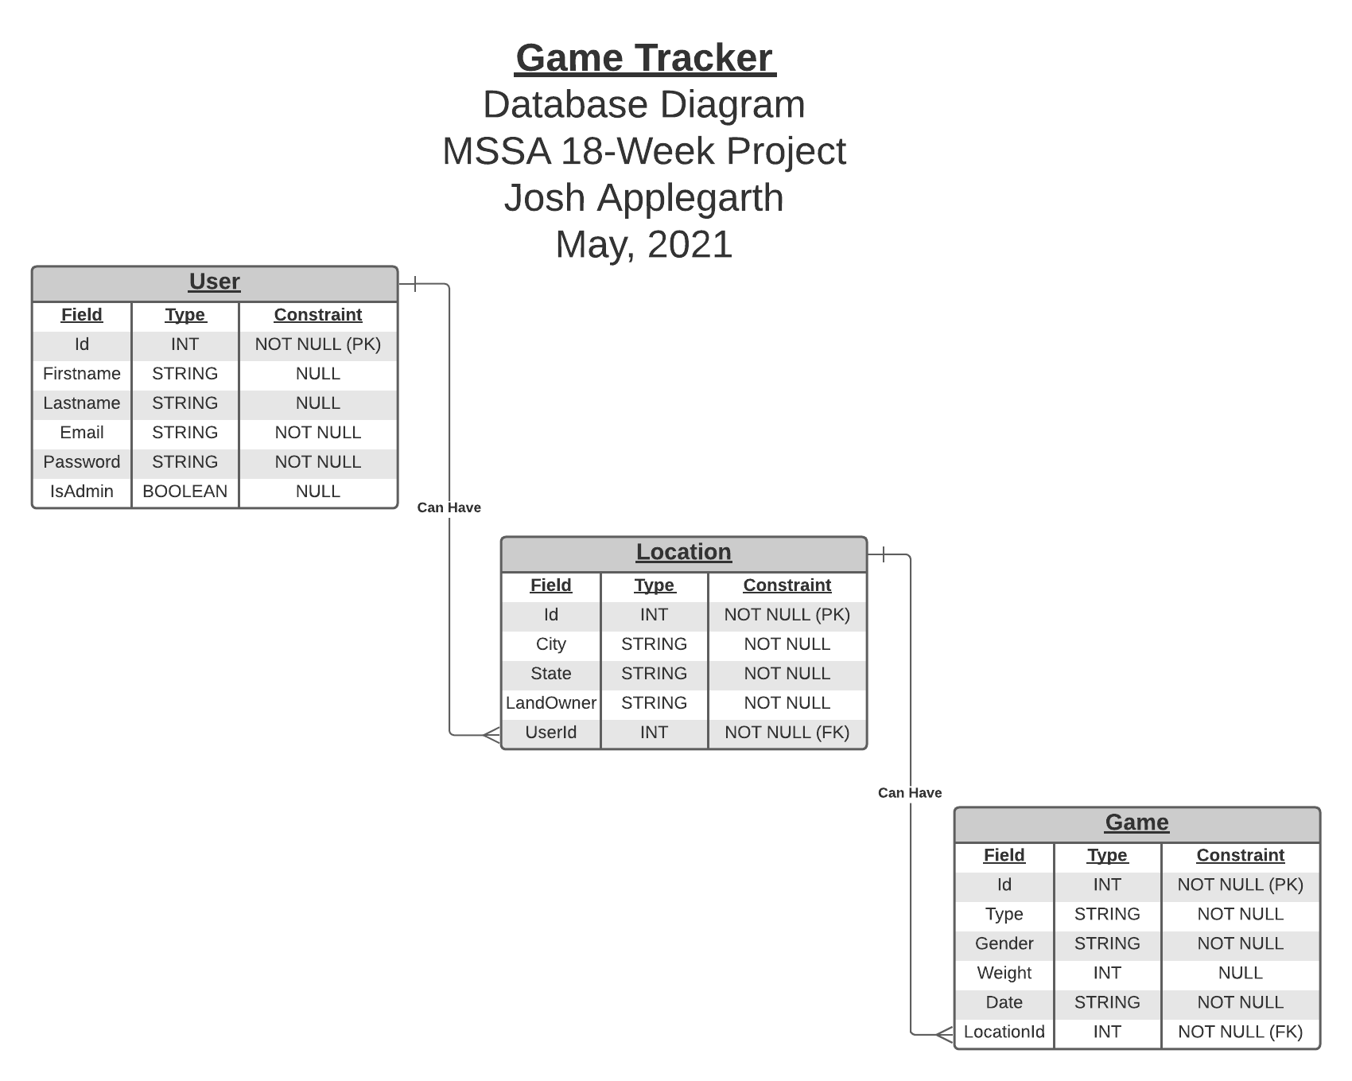

Slide 4

Overview
Log in function
One-to-many relation with User and Location
One-to-many relation with Location and Game Taken

Slide 5
Demo

Slide 6
Improvements
Integrating Into Hunting Area Check-In Web Application
Admin User Function
Adding Pictures on Game Taken
Adding Area Check-In Function

Slide 7
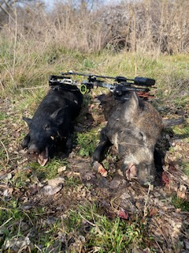
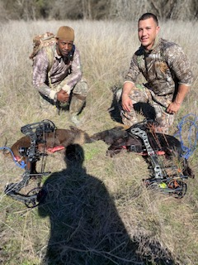
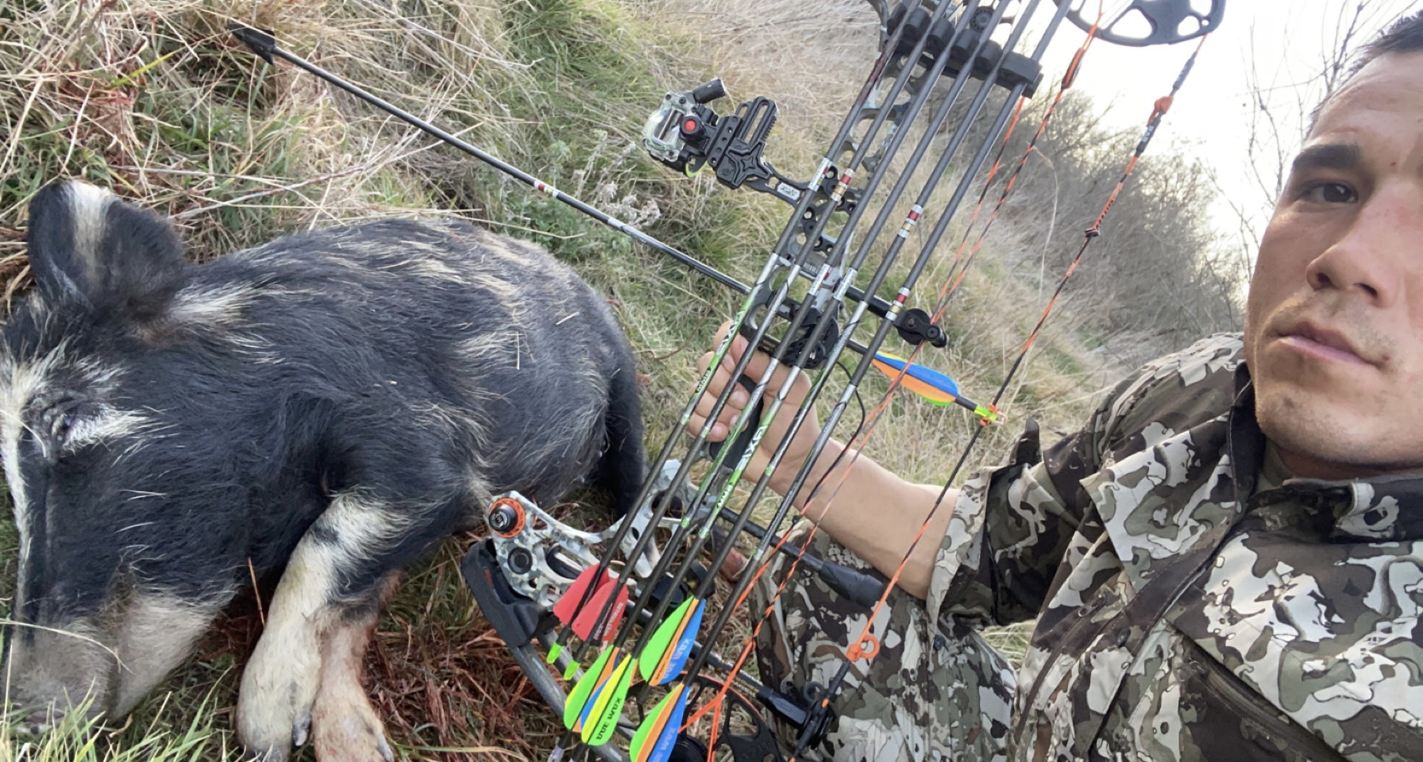
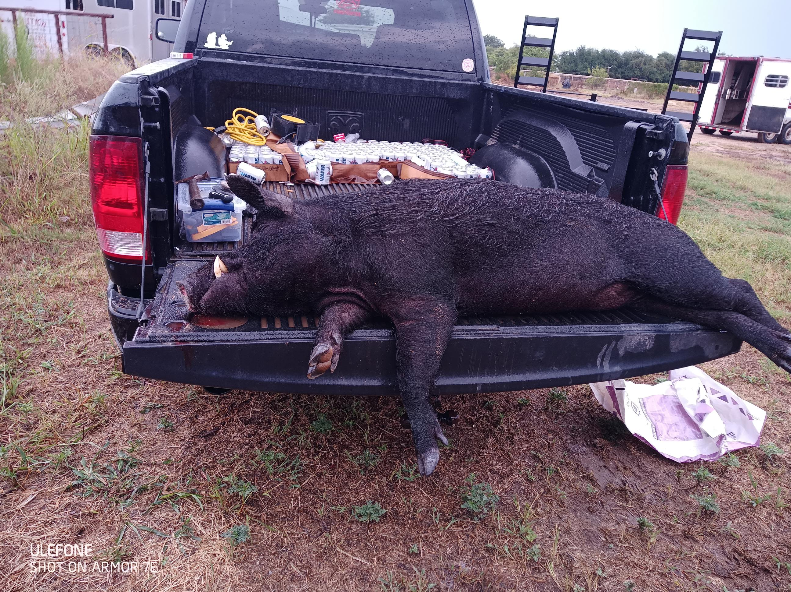
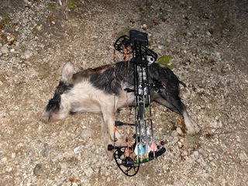
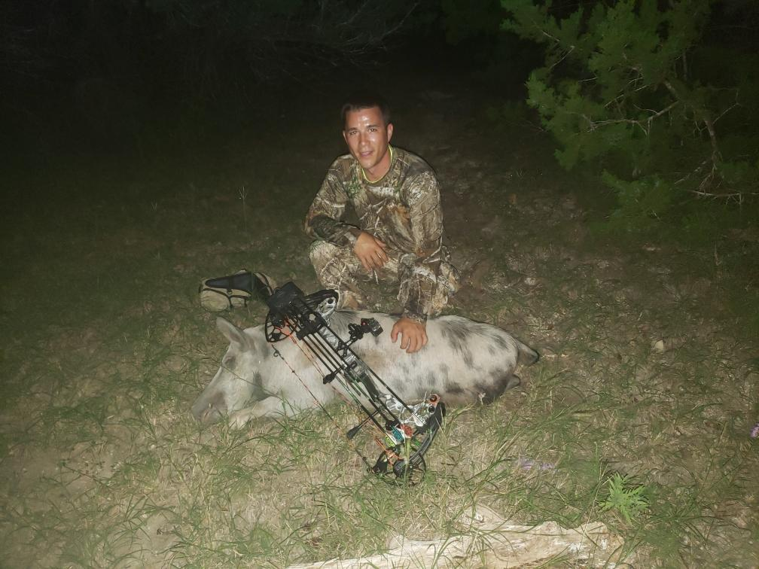

Slide 8
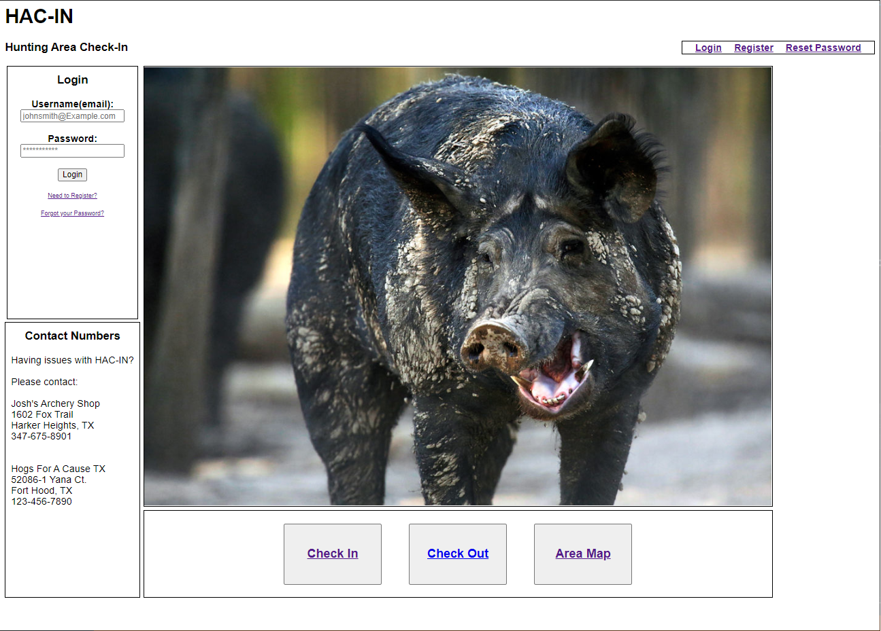

Slide 9
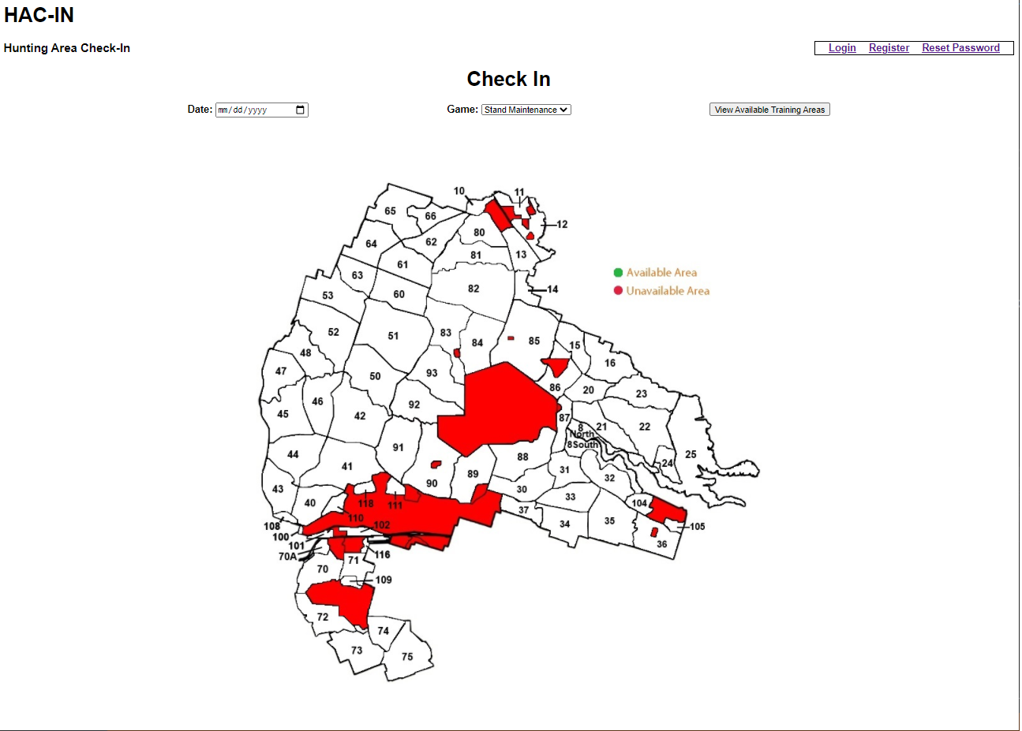

Slide 10
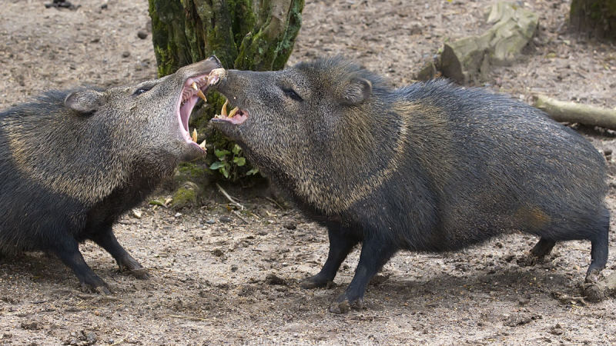
AZURE WEBSITE

Slide 11
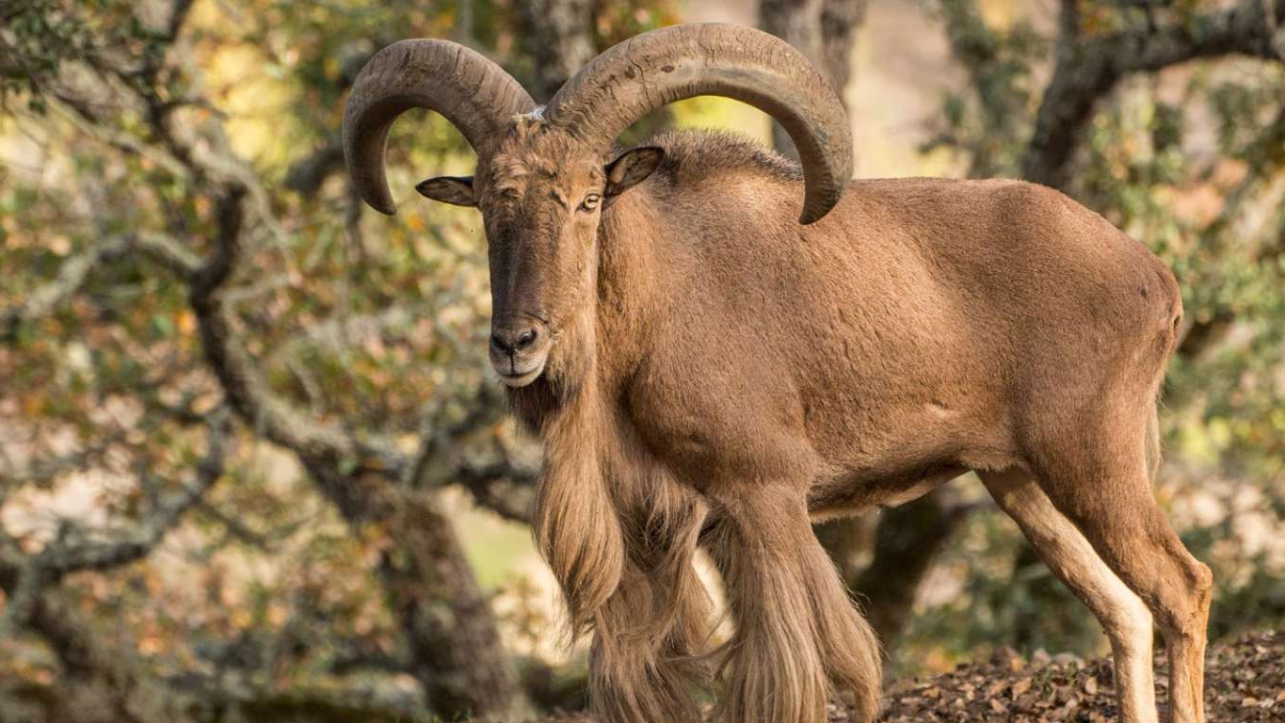
https://github.com/joshapplegarth

Slide 12








Technology used

Slide 13
questions ?

